Slide 1

Intro to Python
Week 2

Slide 2


Slide 3
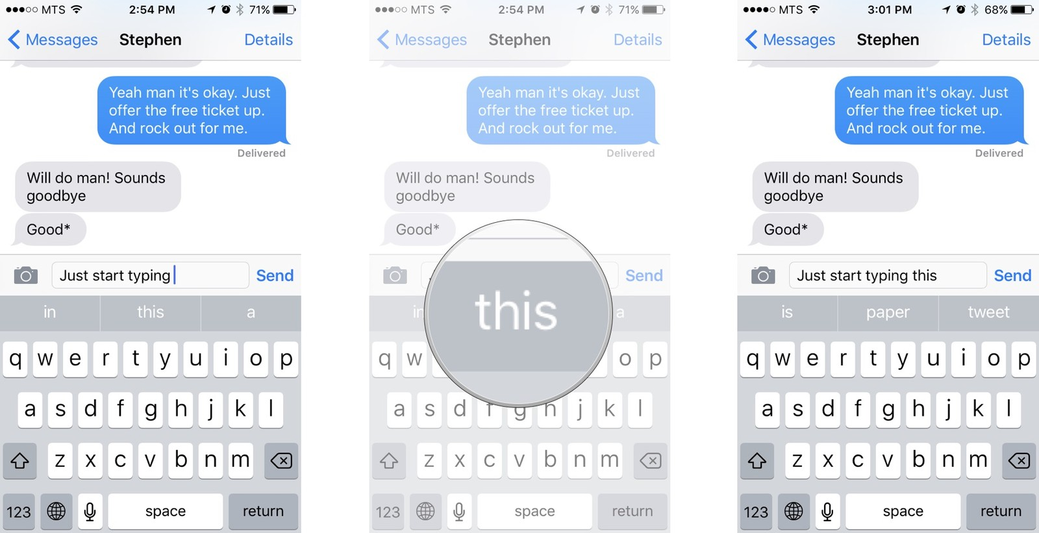

Slide 5
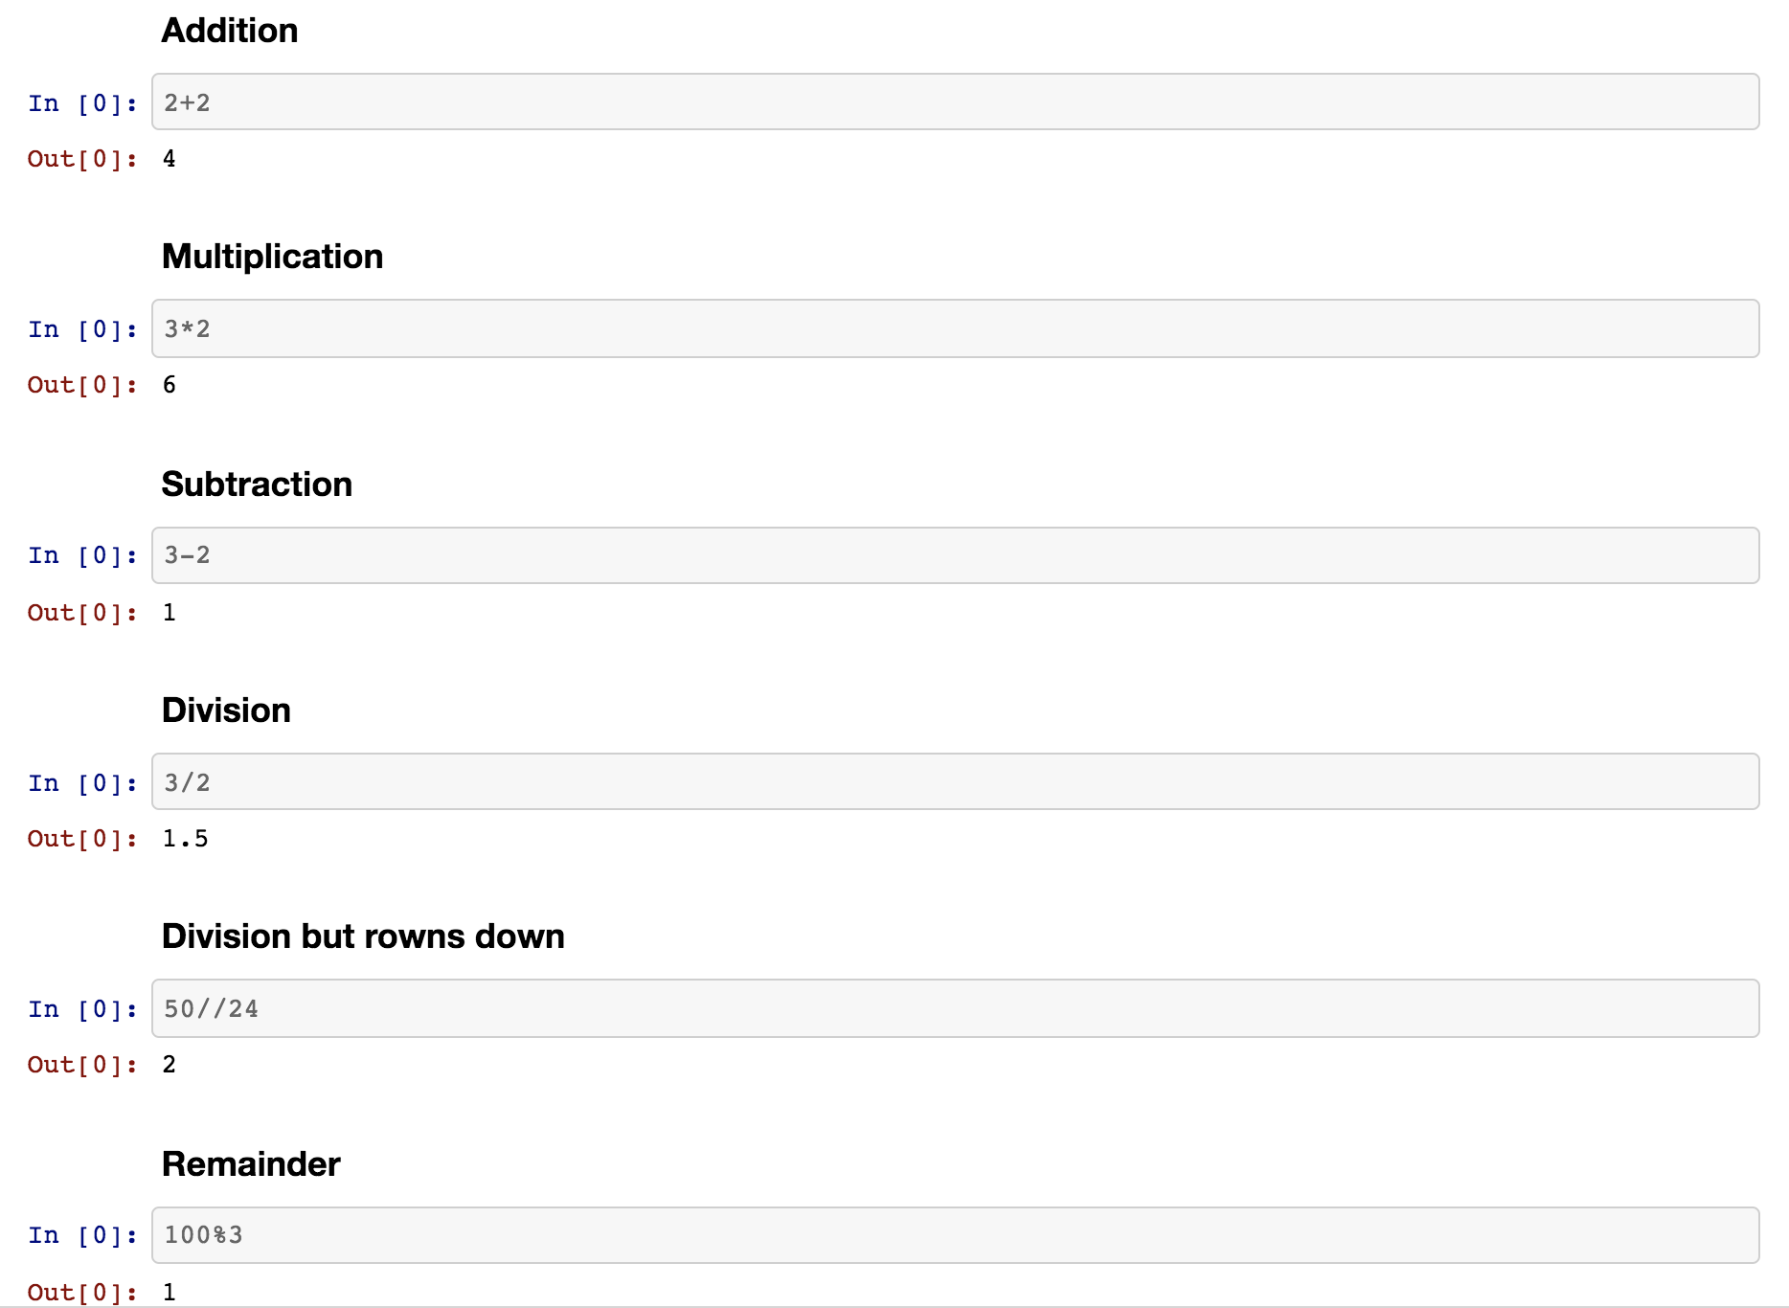

Slide 6
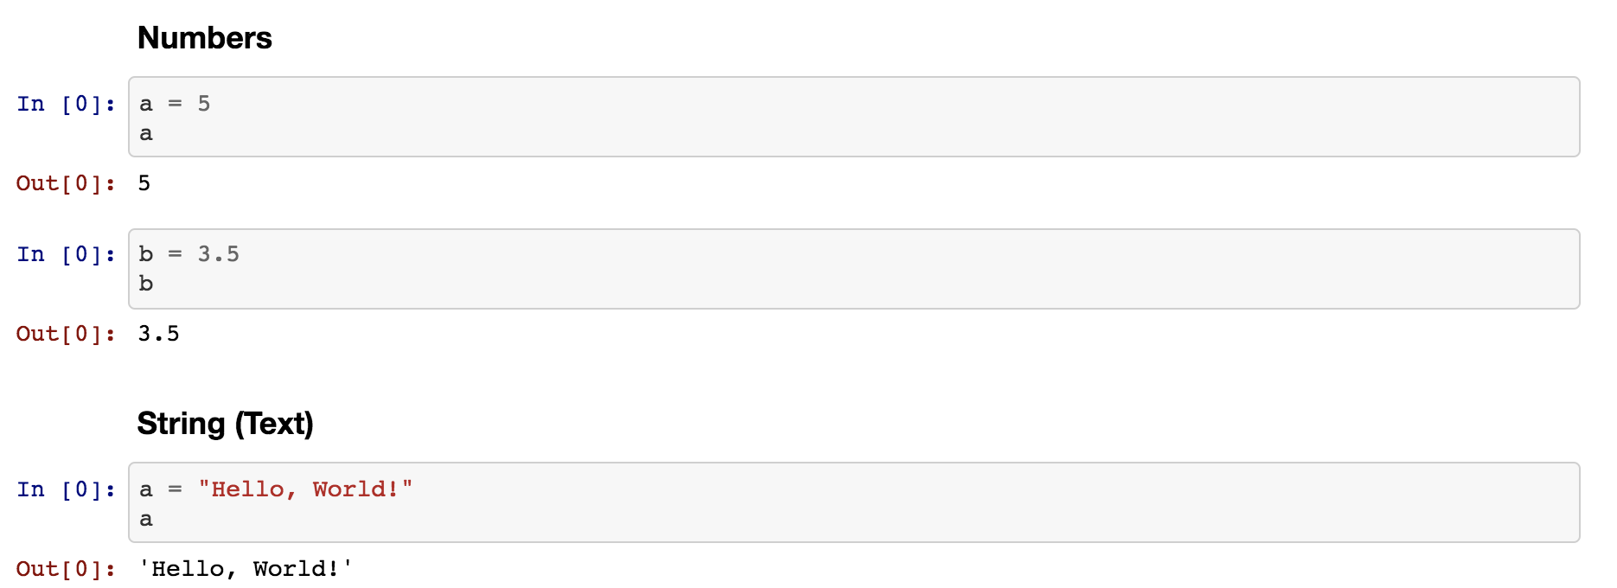

Slide 7
Data Types
Int
str
float

Slide 8
Data Types
Int
str
float
(Numbers)

Slide 9
Data Types
Int
str
(Text)
float
(Numbers)

Slide 10
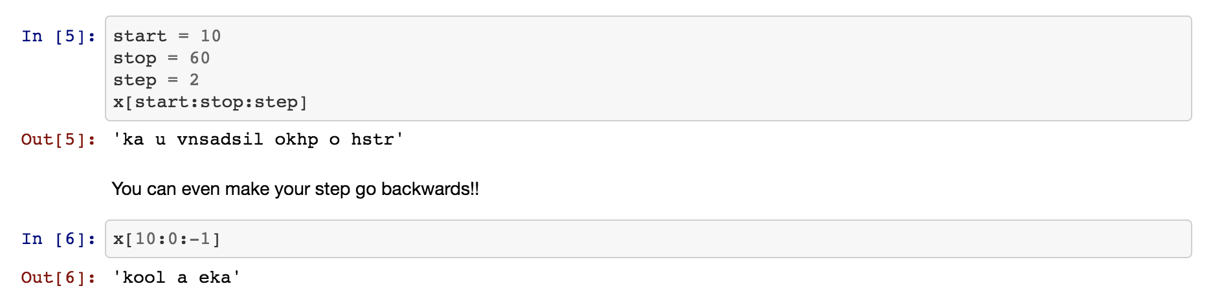
String Indexing

Slide 11
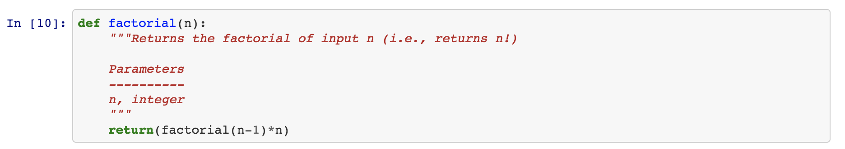
Buggy Recursion

Slide 12
Any Questions?

Slide 13
https://github.com/OxCodeLaborate/IntroToPython

Slide 14
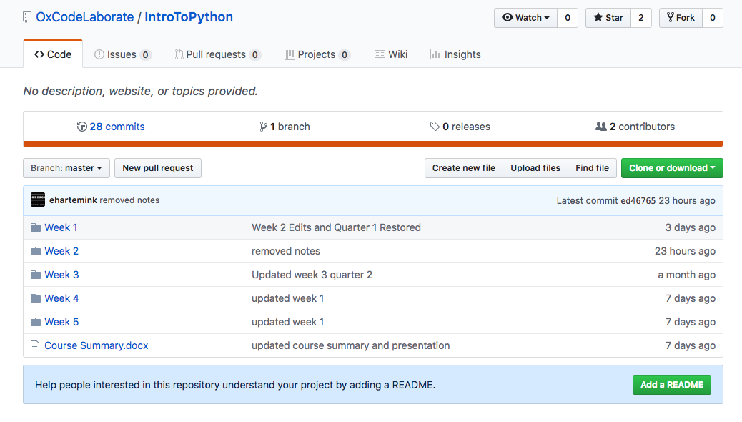
https://github.com/OxCodeLaborate/IntroToPython

Slide 15
https://github.com/OxCodeLaborate/IntroToPython

Slide 16
On Windows
-Open Anaconda Command Prompt
MacOS
-Open Terminal

Slide 17
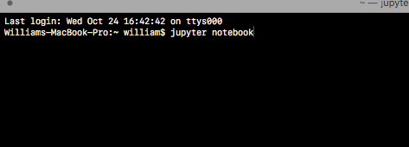
On Windows
-Open Anaconda Command Prompt
MacOS
-Open Terminal

Slide 18
Week 2 Warmup Quiz
https://tinyurl.com/y73w28at

Slide 19
End Quiz
https://tinyurl.com/y8n4xuag

